Slide 1
Thread and thread synchronization

Slide 2
Creating threads

Slide 3
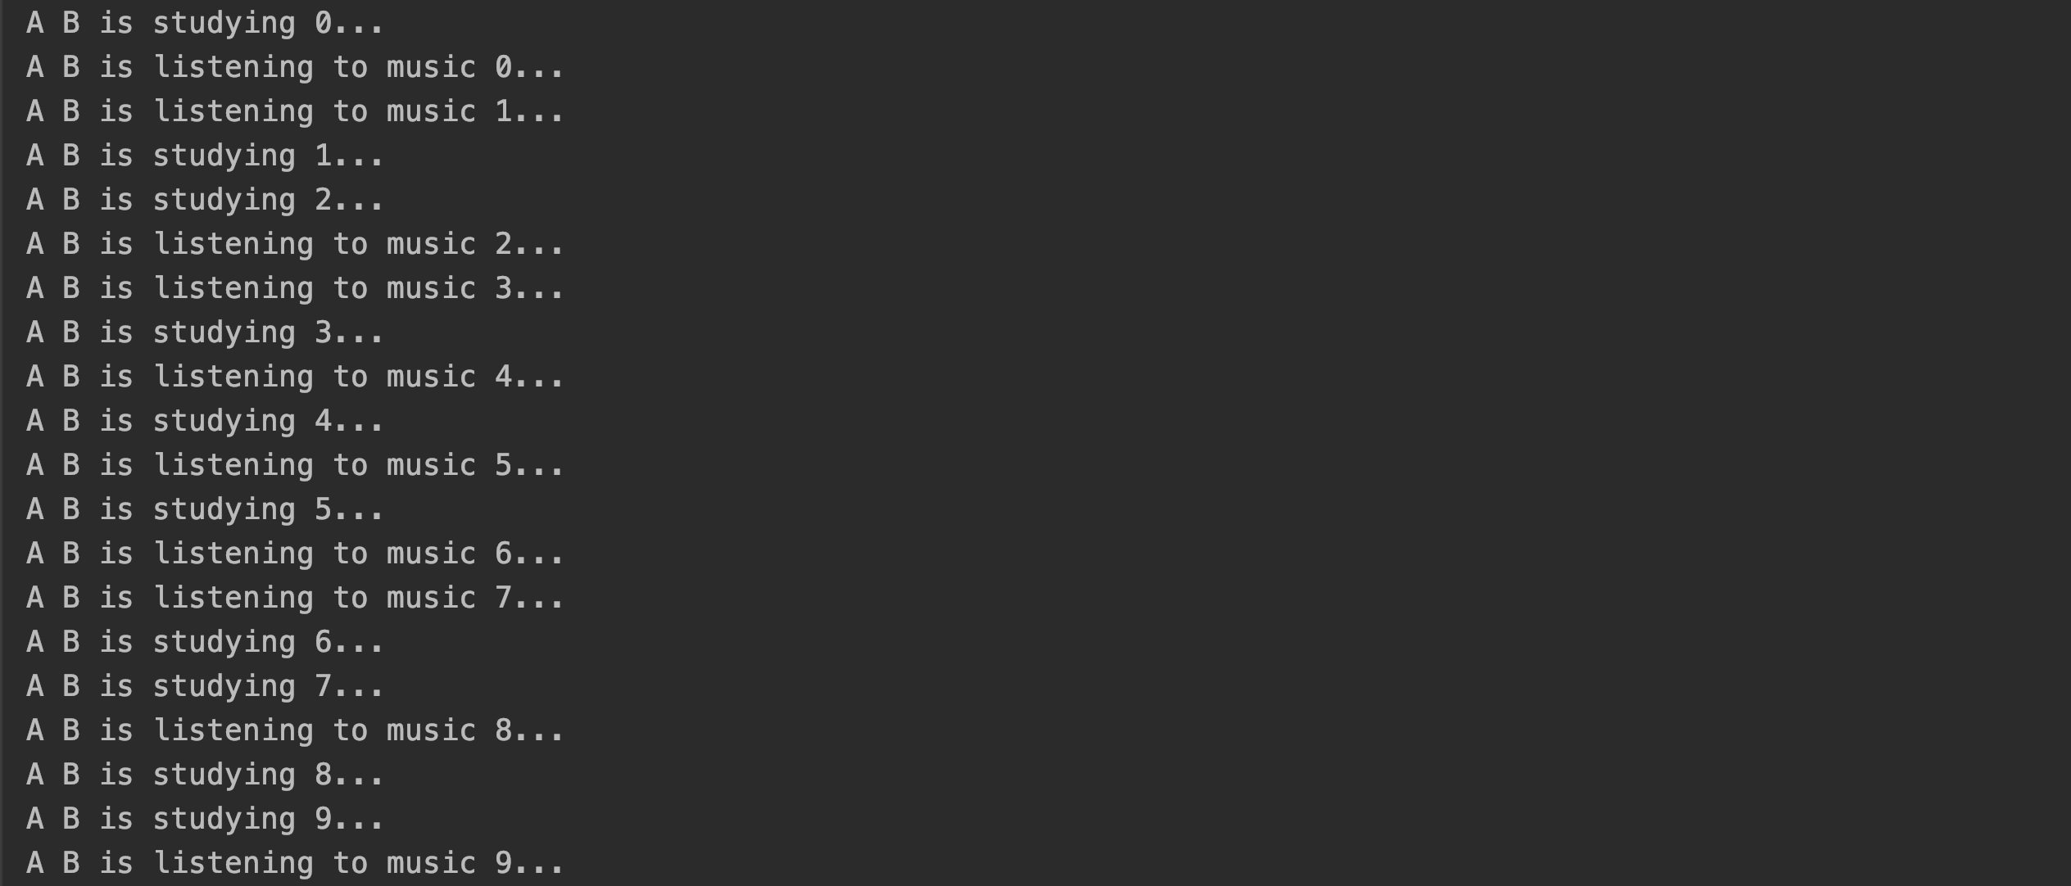
Creating threads

Slide 4
Using ThreadPoolExecutor

Slide 5
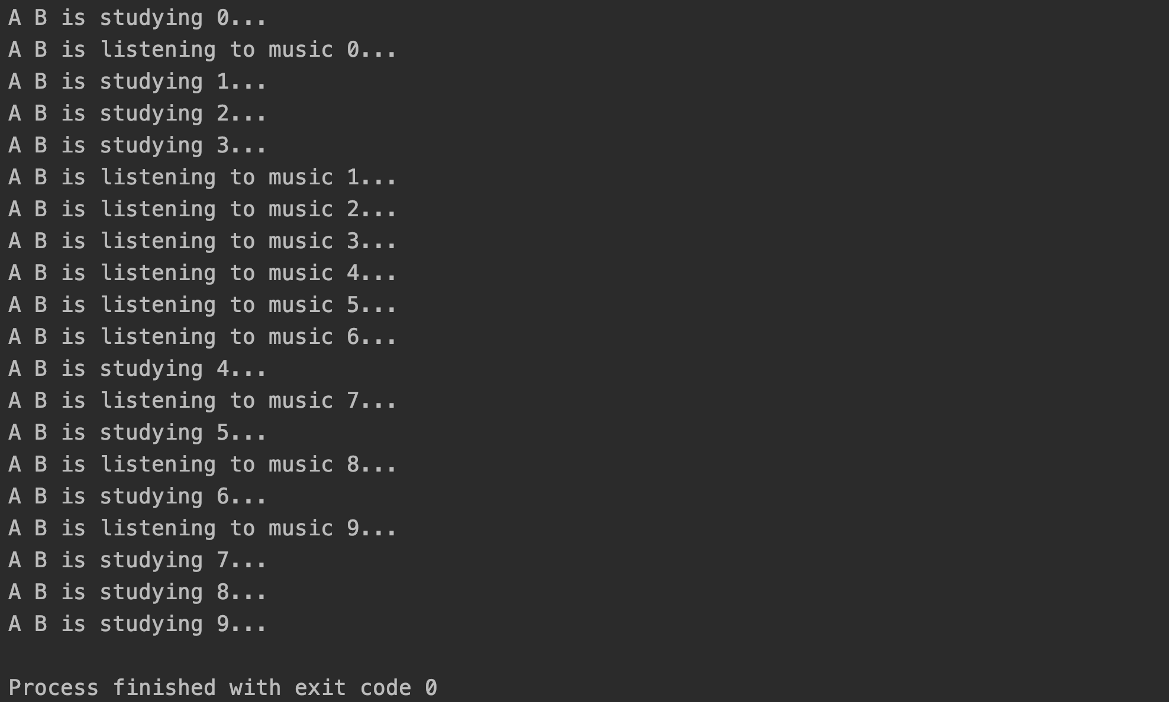
Using ThreadPoolExecutor

Slide 6
The Lost Update Problem (Race condition)
This update is lost
ACC: C
50
150
Bl = 50
Bl = 50
100
TA
Bl = 150
TB
Bl = 100
Bl = 50 + 100
Bl = 50 + 50
  The net effect of the two transactions should be adding 150 to the balance of account C. But it turns out to be adding only 50.

Slide 7
The lost update problem (race condition)

Slide 8
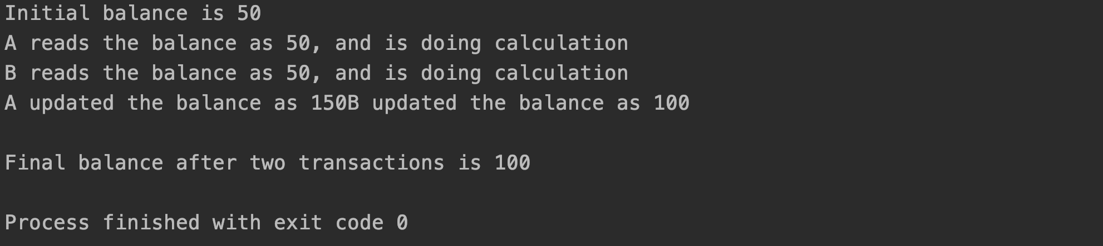
The lost update problem (race condition)

Slide 9
Preventing lost update!
Wait!
L(Bl)
La(Bl)
L(Bl)
ACC:1234
Release Bl
50
150
Bl = 50
TA
TB
Bl = 50 + 100
Bl=150

Slide 10
Preventing lost update!
L(Bl)
Lb(Bl)
L(Bl)
ACC:1234
Release Bl
Release Bl
50
150
Bl = 150
Bl = 50
200
TA
TB
Bl = 50 + 100
Bl = 150 + 50
Bl = 200
Bl=150

Slide 11
Preventing lost update!
L(Bl)
L(Bl)
ACC:1234
Release Bl
Release Bl
50
150
Bl = 150
Bl = 50
200
TA
TB
Bl = 50 + 100
Bl = 150 + 50
Bl = 200
Bl=150
  This solves the problem!

Slide 12
Using Lock

Slide 13
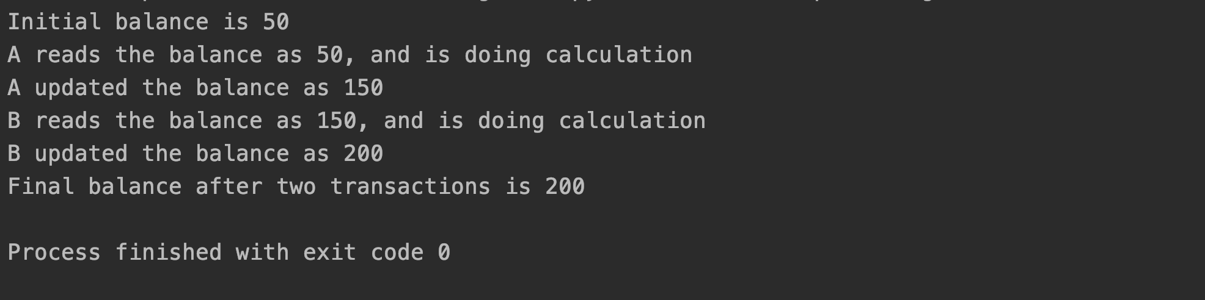
Test

Slide 14
The deadlock
La(P)
Wait!
L(P)
Projector
L(P)
deadlock
TA
TB
L(C)
Computer
L(C)
Wait!
Lb(C)

Slide 15
The deadlock

Slide 16
The deadlock

Slide 17
The deadlock

Slide 18
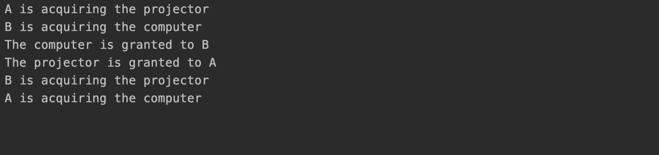
Test
deadlock

Slide 19
Producer/Consumer
Producer
Consumer
1
1
2
2
3
3
4
4
5
5

Slide 20
Producer/Consumer Pattern
Producer
Consumer
1
1
1
2
2
2
3
3
4
5

Slide 21
Producer/Consumer without synchronization

Slide 22
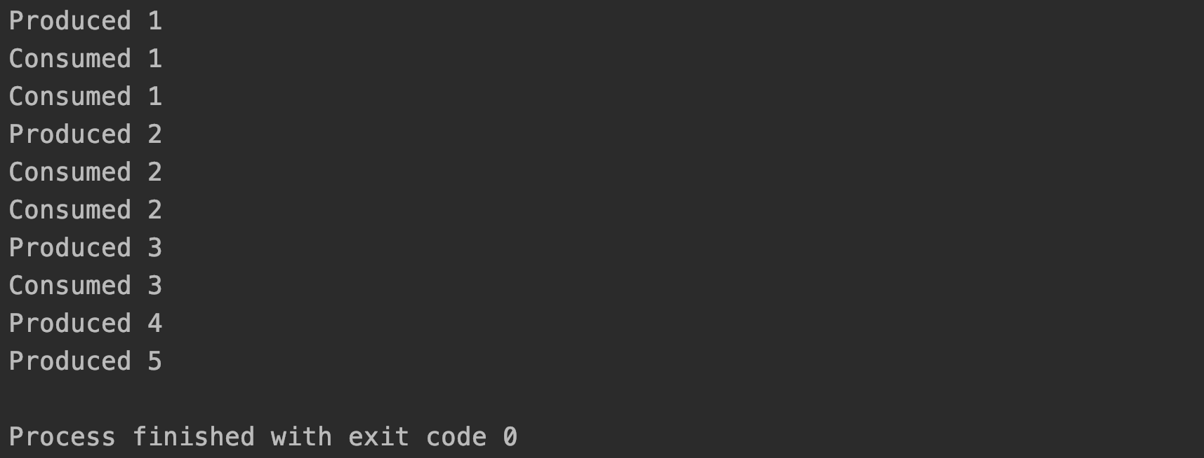
Producer/Consumer with synchronization

Slide 23
Producer/Consumer with synchronization

Slide 24
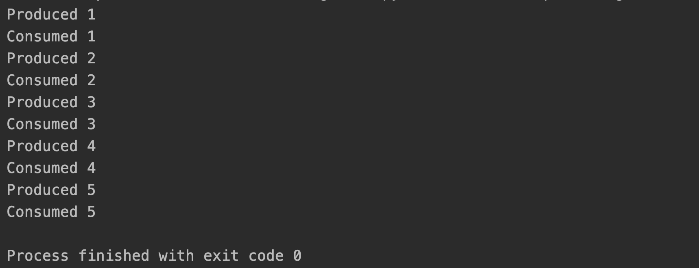
Producer/Consumer with synchronization

Slide 25
References
Python threading video tutorials:
  https://www.youtube.com/watch?v=Sk5LS8-h-KQ&list=PLxyOsIbHSrxl-T-5k1ywTpcQC3gvij0Cz

